Slide 1
MediConnect Online HealthCare App
Medication delivery and Consultation solution
W.M.I.A Gangoda COHNDSE23.3F-039
G.A.S.D Gajadeera COHNDSE23.3F-010
M.N.M. NUSKAN COHNDSE233F-009
A.V.D. JINADASA COHNDSE233F-008

Slide 2
Table of contents
01
04
02
05
03
06
Introduction
Why in Sri Lanka?
Target Audience
Our Solution
Our Mission
Comparison with the existing system
07
08
Monetization Strategy
Our Services

Slide 3
Introduction
Problem Statement :
Difficulty accessing medications for the elderly, disabled, and remote areas.
Inefficiencies in drug delivery due to lack of real-time information.
Language barriers and insufficient personalized health guidance.
Finding the nearest pharmacy can be difficult, particularly in emergencies or
unfamiliar areas.
Difficulty in obtaining timely feedback from doctors on medical reports,
leading to delays in treatment and added stress for patients
Current Issues :
Delays in medication delivery.
Difficulty in finding the right medication due to spelling variations.
Limited support for non-English speakers.
Challenges in locating the nearest pharmacy based on the user's current location.
Lack of an efficient system for obtaining doctor feedback on medical reports,
causing delays in receiving necessary medical advice and prescriptions.
Objective:
Develop a user-friendly app that ensures timely access to medications,
improves user experience and promotes health literacy.

Slide 4
Our Solution
Introducing Our App: A mobile and web-based platform that connects customers
with nearby pharmacies, offering instant access to medication delivery, real-time tracking,
and direct communication with pharmacists.
Home Delivery with Real-Time Tracking
Nearest Pharmacy Locator
Real-Time Chat with Pharmacists
Phonetic Drug Search
Medication List and Order History
Drug Categorization and Filters
Prescription Upload and Verification
Customer Reviews and Ratings
Multi-Lingual Support
Loyalty Points
Purchase Without Prescription
Doctor Payment Packages
Doctor Registration & Feedback on Reports
Key features:

Slide 5
Comparison of our features with the existing application
Feature | Our App | Existing Healthx App
Real-Time Chat with Pharmacists | Allows direct communication with pharmacists for real-time consultations. | Does not support real-time chat with pharmacists.
Phonetic Drug Search | Enables users to find medications even with spelling errors or variations, including purchases without prescriptions. | Lacks support for phonetic search; requires exact drug names and prescription for purchases.
Drug Categorization and Filters | Allows users to browse and filter drugs by categories for easier search. | Does not provide drug categorization or filtering options.
Prescription Upload and Verification (OCR & Camera Access) | Users can upload prescriptions via camera, with OCR technology for verification. | No support for camera-based prescription uploads or OCR verification.
Customer Reviews and Ratings | Enables users to rate and review drugs and pharmacy services. | Lacks a system for customer reviews and ratings.

Slide 6
Continue…
Multi-Lingual Support | Offers support for multiple languages to cater to a diverse user base. | Only supports English; does not cater to non-English speakers.
Loyalty Points | Provides a loyalty program to reward repeat customers. | No loyalty program or reward system for users.
Doctor Registration & Feedback on Reports | Users can send medical reports to registered doctors, who provide feedback and prescriptions via the app. | No option for doctor registration or obtaining feedback on medical reports.
Doctor Payment Packages | Users can purchase monthly, quarterly, or annual packages to receive ongoing medical advice from specialists. | No payment package system for ongoing consultations with doctors
Purchase Without Prescription | Allows users to buy certain drugs without a prescription, using phonetic search and other aids. | Requires a prescription for all drug purchases; no phonetic search support.

Slide 7
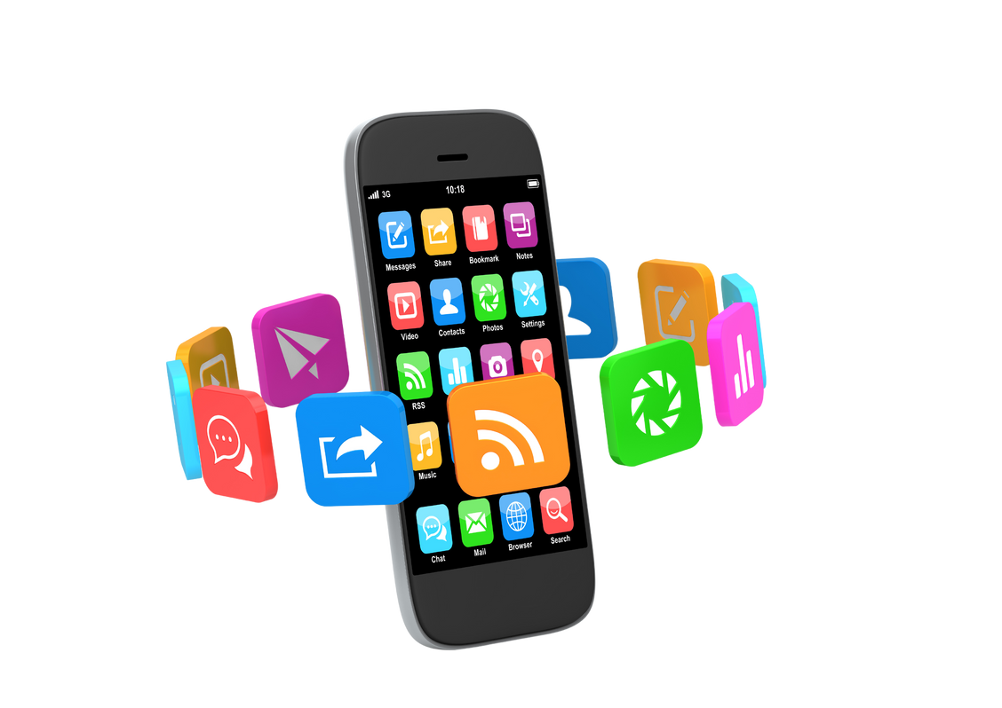
Why in Sri Lanka?
Sri Lanka's healthcare challenges: Limited access, especially in rural areas.
Increasing smartphone and internet usage in Sri Lanka.
The need for an efficient, technology-driven solution in the pharmaceutical
industry.
Impact:
Our app addresses the urgent need for accessible healthcare, promoting better
health outcomes.
Supporting the government’s efforts to digitalize healthcare and improve public
health.

Slide 8
Target Audience
Busy Professionals
Rural Populations
Elderly and Chronically Ill
Those requiring regular medication.
Convenience of home delivery.
Improved access to essential drugs.
Tech-Savvy Millennials
Doctors
Comfortable with app-based services.
Medical professionals who provide consultations

Slide 9
Our Mission
Empowering Healthcare Access for All
Making healthcare accessible, affordable, and convenient for all Sri Lankans.
Providing a reliable platform for accessing medications and health services from
home.

Slide 10
Our Services
On-Demand Drug Delivery: Fast, reliable delivery with tracking.
Health Consultations: Chat with licensed pharmacists for advice.
Doctor Registration & Feedback on Reports: Register doctors to
receive medical reports, get feedback and prescriptions directly
through the app.
Loyalty Programs: Rewards for regular customers.
Nearest Pharmacy Locator: Quickly find the nearest pharmacy
with real-time distance, contact details, and services offered.

Slide 11
Monetization Strategy
Delivery Fees
Premium Subscription
Pharmacy Partnerships
Affordable fees for
service sustainability
Premium Version:
Priority Service
Discounts and Special Offers
Enhanced Features
Commission-based partnerships with local pharmacies

Slide 12
THANK YOU !!!

